Slide 1
Performance Optimization (database query)

Slide 2


Slide 3
Index creation decision
When to Create Indexes:
Columns frequently used in WHERE clauses
JOIN columns
ORDER BY columns
Columns with high selectivity
Foreign key columns
When NOT to Create Indexes:
Small tables (< 1000 rows)
Columns with low selectivity
Frequently updated columns
Tables with high INSERT/UPDATE activity

Slide 4
Explain Plan Is Oracle's query execution plan analyzer that shows exactly how Oracle will execute your SQL statement without actually running it.
Why it matters
Shows the cost of operations (Oracle's estimate of resources needed)
Reveals access paths (table scans vs index usage)
Identifies join methods and their efficiency
Helps predict performance bottlenecks

Slide 5
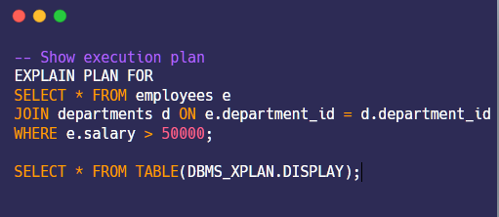
hoW TO Explain Plan

Slide 6
Common anti pattern An anti-pattern in software engineering, project management, and business processes is a common response to a recurring problem that is usually ineffective and risks being highly counterproductive.
N+1 Query Problem
SELECT * Anti-Pattern
Wildcard Search Anti-Patterns
JOIN Anti-Patterns

Slide 7
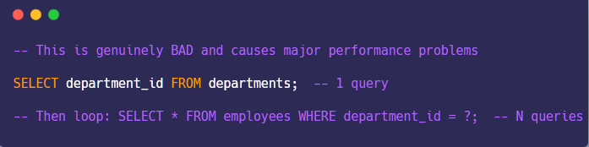
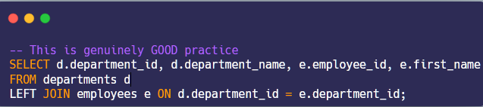
N+1 Query Problem Why it's genuinely bad: Real performance impact: 100x slower in production Network overhead: Multiple round trips to database Connection exhaustion: Can crash your application Resource waste: Each query uses CPU, memory, locks
Don’t
Do

Slide 8
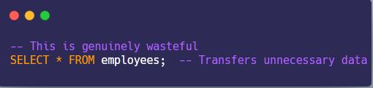
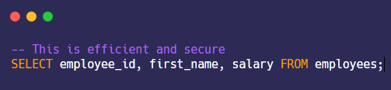
SELECT * Anti-Pattern Why it's genuinely bad: Network bandwidth: 10MB vs 1MB data transfer Memory usage: Application crashes from large result sets Security risk: Exposing sensitive columns accidentally
Don’t
Do

Slide 9
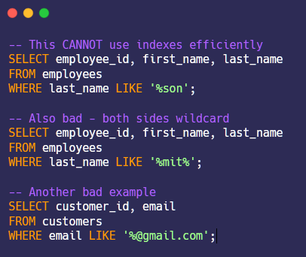
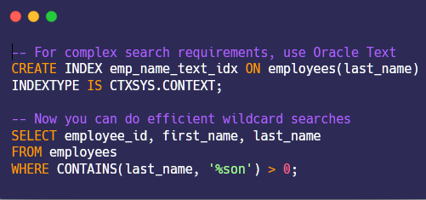
Wildcard Search Anti-Patterns Why it's genuinely bad: Full table scan: Oracle must check every row Index is useless: Can't use B-tree indexes Performance degrades: Gets worse as table grows
Don’t Do

Slide 10
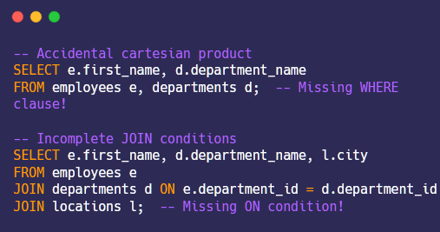
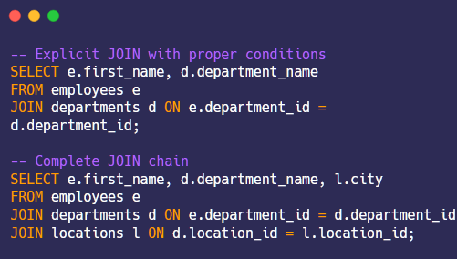
JOIN Anti-Patterns Why it's genuinely bad: Explosive result set: If you have 1,000 employees and 10 departments, you get 10,000 rows instead of 1,000 Memory exhaustion: Application can crash from massive result sets Network overload: Transfers gigabytes of duplicate data Performance killer: Query time grows exponentially Wrong business logic: Shows incorrect relationships
Don’t Do

Slide 11
Performance difference
Anti-Pattern | Time Before | Time After | Improvement | Rows Processed | Key Metric
N+1 Queries | 2.5 sec | 0.08 sec | 31x faster | 11 queries → 1 query | Network round trips
**SELECT *** | 0.45 sec | 0.12 sec | 3.8x faster | 50KB → 12KB data | Data transfer
Leading Wildcard | 0.8 sec | 0.02 sec | 40x faster | 200 rows → 15 rows | Full scan vs Index
Cartesian JOIN | 15 sec | 0.15 sec | 100x faster | 2000 rows → 200 rows | Result set size

Slide 12
Q/A

Slide 13

Thank you

